Slide 1
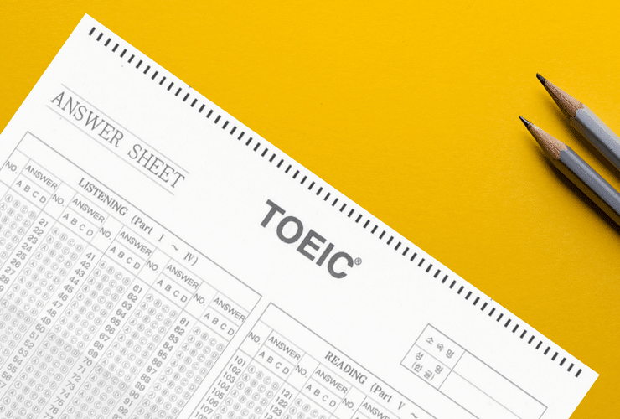
TOEIC Test
Test Of English for International Communication

Slide 2
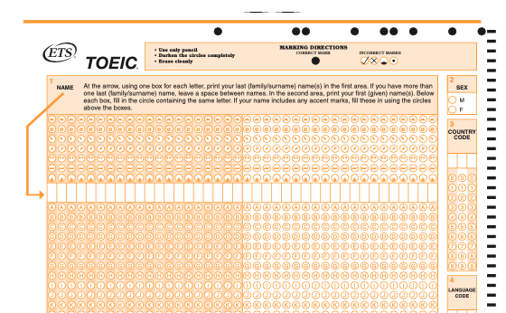

TOEIC Test
The Test of English for International Communication (TOEIC) is an English-language proficiency test for people whose native language is not English.
It measures the everyday English skills of people working in an international environment.

Slide 3
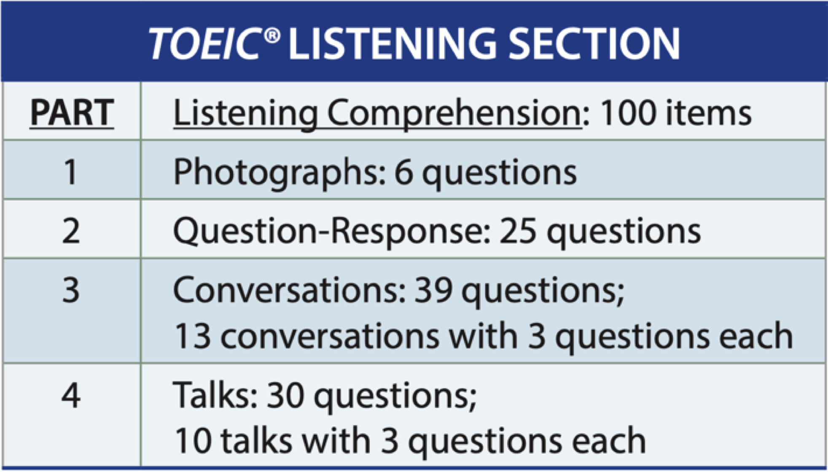
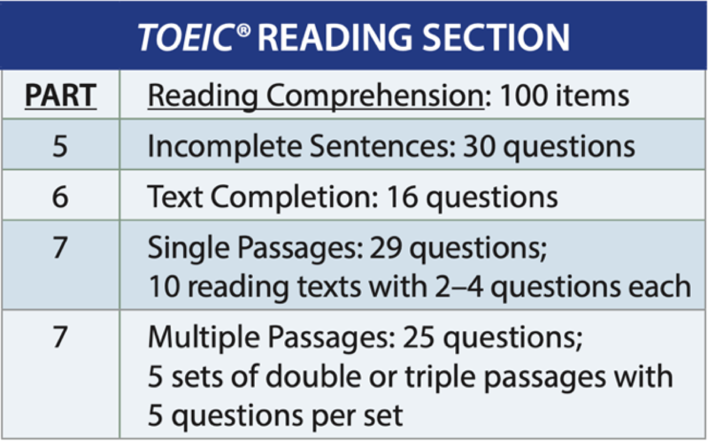
TOEIC Test format
The TOEIC test is a 2-hour multiple-choice test that consists of 200 questions divided into 2 sections:
Listening Section: It consists of four parts and contains 100 questions
Total time: approximately 45 minutes.
Reading Section: You will read a variety of materials and respond at your own pace to 100 questions.
Total time: 75 minutes.

Slide 5
Score requirements

Slide 6
กระบวนการเรียนรู้ (Learning Procedures)
learning contents
(TOEIC tactics)
practice test
Getting feedback
Practice self-test, Mini-test

Slide 7

Question?

Slide 8
Pretest
TOEIC
Test Of English for International Communication

Slide 11
Score requirements

Slide 12

Evaluation
20%
การมีส่วนร่วมในชั้นเรียน (Class attendance and participation)
**เข้าเรียนไม่ต่ำกว่า 32 ชม. หรือ 80% ของเวลาเรียนทั้งหมด
20%
สอบท้ายบทเรียน (Final test)
20%
40%
8 ข้อสอบชุดฝึกที่ทำด้วยตนเอง(8 Practice Self-test)
4 ข้อสอบย่อย (4 Mini-tests)

Slide 13
กระบวนการเรียนรู้ (Learning Procedures)
learning contents
(TOEIC tactics)
practice test
Getting feedback
Practice self-test, Mini-test

Slide 14
Treasure hunt
BANGKOK BUSINESS BUILDING – BB BUILDING
SUITE 1907, 19TH FLOOR, 54 ASOKE ROAD SUKHUMVIT BANGKOK 10110 THAILAND
1. Test of English for International Communication
2. Listening and Reading
3. 990
4. There 5. BANGKOK BUSINESS BUILDING – BB BUILDING
SUITE 1907, 19TH FLOOR, 54 ASOKE ROAD SUKHUMVIT BANGKOK 10110 THAILAND
are a lot of companies. (Thai Airways / SCG / RMUTK / Honda / )
6. 4 parts : Photographs / Question-Response / Conversations / Talks

Slide 15
7. 3 parts: Incomplete sentences / Text completion / Single passage
8.
PTT | SCG | Honda | Thai Air Asia
Consultant | Analyst | Purchasing | Ground officer
Export Sales | Secretary | Logistic officer | Flight attendant
550
550
600
550
600
550
650
650

Slide 16
Pretest

Slide 17
The End

